Slide 1
Database Systems: Theory and Programming Oracle Spatial
Notes:
Replace this with your course title and your name/contact details.

Slide 2

Acknowledgements
Material and examples for this PowerPoint deck come from:
Pro Oracle Spatial for Oracle Database 11g. Ravikanth Kothuri, Albert Godfrind, Euro Beinat. 2007. Apress

Slide 3
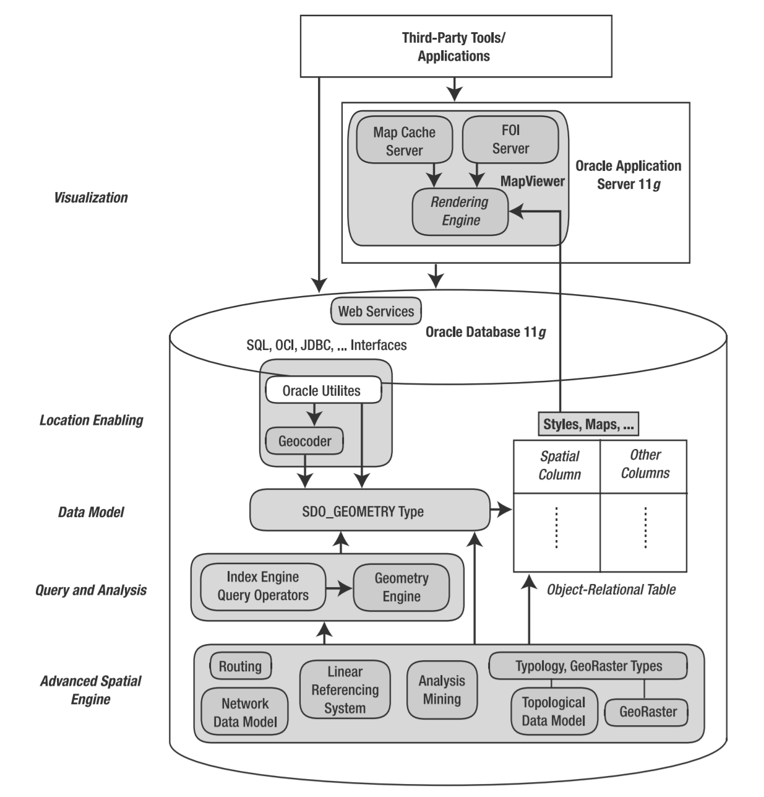
Architecture
Data model: Oracle Spatial uses a SQL data type, SDO_GEOMETRY, to store spatial data in an Oracle database to store locations or locations with spatial extents
Location enabling: street addresses, can be converted into SDO_GEOMETRY columns using the geocoder component of Oracle Spatial
Other tools such as Visualization, Analysis…

Slide 4
Managing Geometry
Location
Specifies where the data is located with respect to a two-, three-, or four-dimensional coordinate space.
For instance, the center of San Francisco is located at coordinates (–122.436, 37.719) in the two-dimensional “latitude, longitude” space.
Shape
Specifies the geometric structure of the data.
Point, line, and polygon are examples of possible shapes
Shape could specify a line or a polygon connecting multiple points (specified by their locations). For instance, the city boundary of San Francisco could be a polygon connecting multiple points.
In some applications, the shapes could be more complex and could have multiple polygons and/or polygons containing holes.

Slide 5
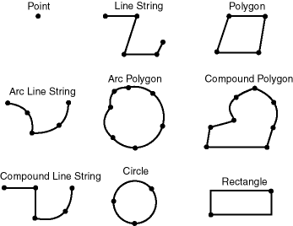

Possible 2D Geometries
Points and Lines
Polygons:
A ring of straight lines (next few examples)
A ring of arcs
A rectangle
A circle
A "compound polygon" where the boundary is connected by both straight lines and circular arcs.
A "voided polygon" where there is a "hole" in the middle
A collection
Think about the "Hawaii polygon" where Hawaii is represented by polygons for every Hawaiian island.
Voided Polygon

Slide 6
Regions
500
R16
R15
R14
R13
450
400
R9
R10
350
R11
R12
300
250
R8
R7
R6
R5
200
150
R2
R3
100
R1
R4
50
0
0
50
100
150
200
250
300
350
400
450
500

Slide 7
Using SDO_GEOMETRY
--create table of regions
CREATE TABLE GREGION (region_id VARCHAR2(20 BYTE) PRIMARY KEY,
shape SDO_GEOMETRY NOT NULL);
--insert value
INSERT INTO GREGION VALUES(
'R4',
SDO_GEOMETRY(
2003,
NULL,
NULL,
SDO_ELEM_INFO_ARRAY(1,1003,1),
SDO_ORDINATE_ARRAY(400,0,500,0,500,100,400,100,400,0)
)
);
Since SDO_GEOMETRY is an object type, just like any other object type, you can
populate an SDO_GEOMETRY column using the corresponding object constructor.

Slide 8
Analyzing the Constructor: "GEO_TYPE"
CREATE TYPE sdo_geometry AS OBJECT (
SDO_GTYPE NUMBER,
SDO_SRID NUMBER,
SDO_POINT SDO_POINT_TYPE,
SDO_ELEM_INFO MDSYS.SDO_ELEM_INFO_ARRAY,
SDO_ORDINATES MDSYS.SDO_ORDINATE_ARRAY);
INSERT INTO GREGION VALUES(
'R4',
SDO_GEOMETRY(
2003,
NULL,
NULL,
SDO_ELEM_INFO_ARRAY(1,1003,1),
SDO_ORDINATE_ARRAY(400,0,500,0,500,100,400,100,400,0)
)
);
1st digit (d) is dimension
2nd digit (l) is linear referencing (3D systems only)
2003 means 2D polygon
Value | Geometry Type | Description
dl00 | UNKNOWN_ GEOMETRY | Spatial ignores this geometry.
dl01 | POINT | Geometry contains one point.
dl02 | LINE or CURVE | Geometry contains one line string that can contain straight or circular arc segments, or both. (LINE and CURVE are synonymous in this context.)
dl03 | POLYGON | Geometry contains one polygon with or without holes.
dl04 | COLLECTION | Geometry is a heterogeneous collection of elements.^{Foot 2} COLLECTION is a superset that includes all other types.
dl05 | MULTIPOINT | Geometry has one or more points. (MULTIPOINT is a superset of POINT.)
dl06 | MULTILINE or MULTICURVE | Geometry has one or more line strings. (MULTILINE and MULTICURVE are synonymous in this context, and each is a superset of both LINE and CURVE.)
dl07 | MULTIPOLYGON | Geometry can have multiple, disjoint polygons (more than one exterior boundary). (MULTIPOLYGON is a superset of POLYGON.)

Slide 9
Analyzing the Constructor: SRID, POINT
CREATE TYPE sdo_geometry AS OBJECT (
SDO_GTYPE NUMBER,
SDO_SRID NUMBER,
SDO_POINT SDO_POINT_TYPE,
SDO_ELEM_INFO MDSYS.SDO_ELEM_INFO_ARRAY,
SDO_ORDINATES MDSYS.SDO_ORDINATE_ARRAY);
--insert value
INSERT INTO GREGION VALUES(
'R4',
SDO_GEOMETRY(
2003,
NULL,
NULL,
SDO_ELEM_INFO_ARRAY(1,1003,1),
SDO_ORDINATE_ARRAY(400,0,500,0,500,100,400,100,400,0)
)
);
SDO_SRID can be used to identify a coordinate system (spatial reference system) to be associated with the geometry.
Coordinates can be Cartesian, Geographic (longitude/latitude), Planar, Authalic…
SDO_POINT only used for GEOTYPE dl01 (point types)

Slide 10

Analyzing the Constructor: SRID, POINT (2)
CREATE TYPE sdo_geometry AS OBJECT (
SDO_GTYPE NUMBER,
SDO_SRID NUMBER,
SDO_POINT SDO_POINT_TYPE,
SDO_ELEM_INFO MDSYS.SDO_ELEM_INFO_ARRAY,
SDO_ORDINATES MDSYS.SDO_ORDINATE_ARRAY);
--insert value
INSERT INTO GLION VALUES(
'L14',
SDO_GEOMETRY(
2001,
NULL,
SDO_POINT_TYPE(350,50,NULL),
NULL,
NULL
)
);
Here's a Lion defined by his point.
X: 350, Y: 50, Z: null (only 2 dimensional point)
Segueing, for a moment, into defining points…

Slide 11
Analyzing the Constructor: ELEM_INFO
CREATE TYPE sdo_geometry AS OBJECT (
SDO_GTYPE NUMBER,
SDO_SRID NUMBER,
SDO_POINT SDO_POINT_TYPE,
SDO_ELEM_INFO MDSYS.SDO_ELEM_INFO_ARRAY,
SDO_ORDINATES MDSYS.SDO_ORDINATE_ARRAY);
INSERT INTO GREGION VALUES(
'R4',
SDO_GEOMETRY(
2003,
NULL,
NULL,
SDO_ELEM_INFO_ARRAY(1,1003,1),
SDO_ORDINATE_ARRAY(400,0,500,0,500,100,400,100,400,0)
)
);
SDO_ELEM_INFO is a varying length array of numbers. This attribute lets you know how to interpret the ordinates stored in the SDO_ORDINATES attribute
SDO_STARTING_OFFSET: (where the 1st ordinate is stored, generally "1" not 0 for 1st element!)
SDO_ETYPE:
1003: exterior polygon ring or "perimeter" (must be specified in counterclockwise order)
2003: interior polygon ring or "hole" (must be specified in clockwise order)
SDO_INTERPRETATION
1: simple polygon – two points per vertice (last vertice must be same as first vertice to close the polygon)
2: polygon of arcs -- three points per arc (start point, any point on arc, end point)
3: rectangle – two points: lower left and upper right
4: circle – three points on circle's circumference

Slide 12
Analyzing the Constructor: ORDINATES
CREATE TYPE sdo_geometry AS OBJECT (
SDO_GTYPE NUMBER,
SDO_SRID NUMBER,
SDO_POINT SDO_POINT_TYPE,
SDO_ELEM_INFO MDSYS.SDO_ELEM_INFO_ARRAY,
SDO_ORDINATES MDSYS.SDO_ORDINATE_ARRAY);
INSERT INTO GREGION VALUES(
'R4',
SDO_GEOMETRY(
2003,
NULL,
NULL,
SDO_ELEM_INFO_ARRAY(1,1003,1),
SDO_ORDINATE_ARRAY(400,0,500,0,500,100,400,100,400,0)
)
);
The SDO_ORDINATES attribute is defined using a varying length array of NUMBER type that stores the coordinate values that make up the boundary of a spatial object.
Always used in conjunction with the SDO_ELEM_INFO
For example, a polygon whose boundary has four two-dimensional points is stored as {X1, Y1, X2, Y2, X3, Y3, X4, Y4, X1, Y1}.
For a polugon of arcs, the coordinates for a point designating the end of one arc and the start of the next arc are not repeated. For example, five coordinates are used to describe a polygon made up of two connected circular arcs. Points 1, 2, and 3 define the first arc, and points 3, 4, and 5 define the second arc. The coordinates for points 1 and 5 must be the same to close the shape and point 3 is not repeated.

Slide 13
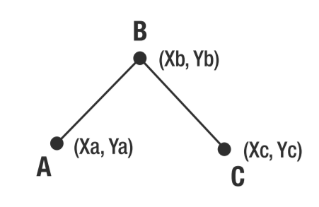
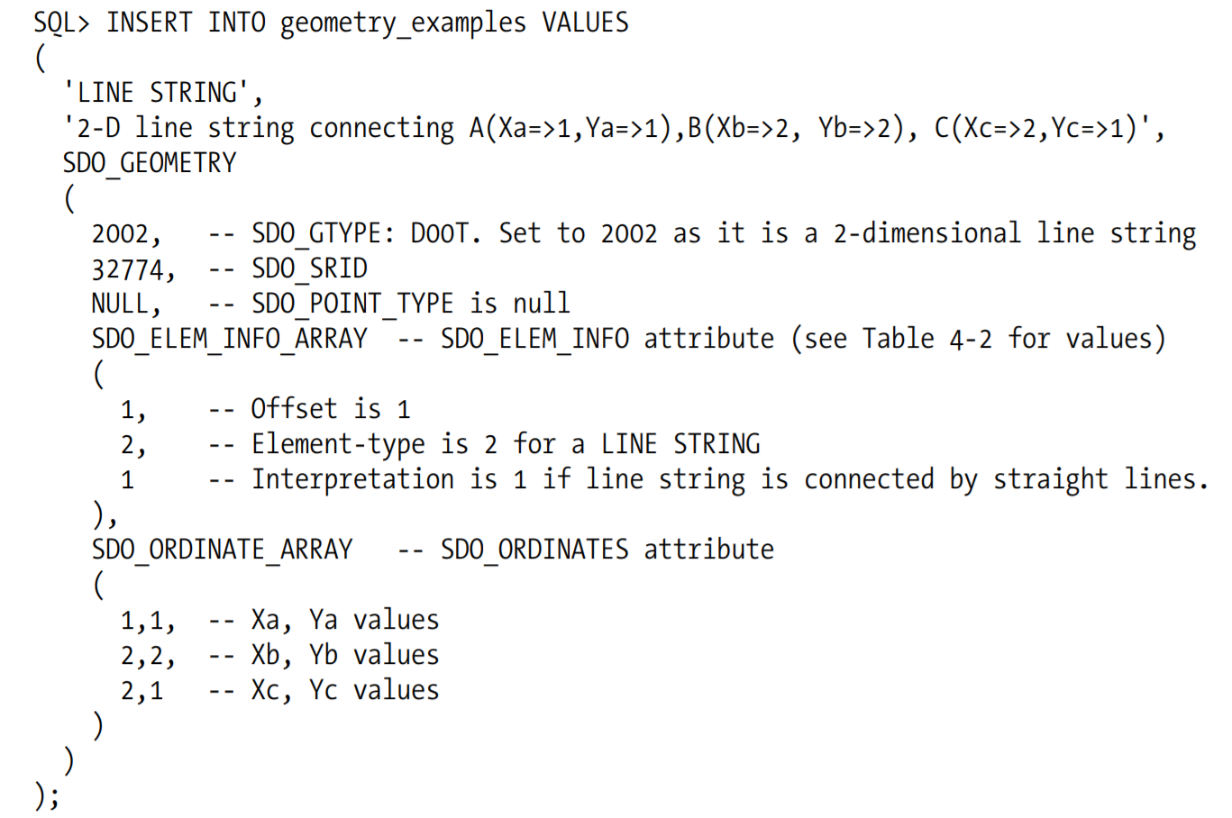
Creating lines (1)
You can create straight lines using Oracle Spatial

Slide 14
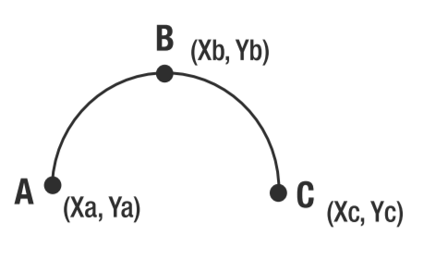
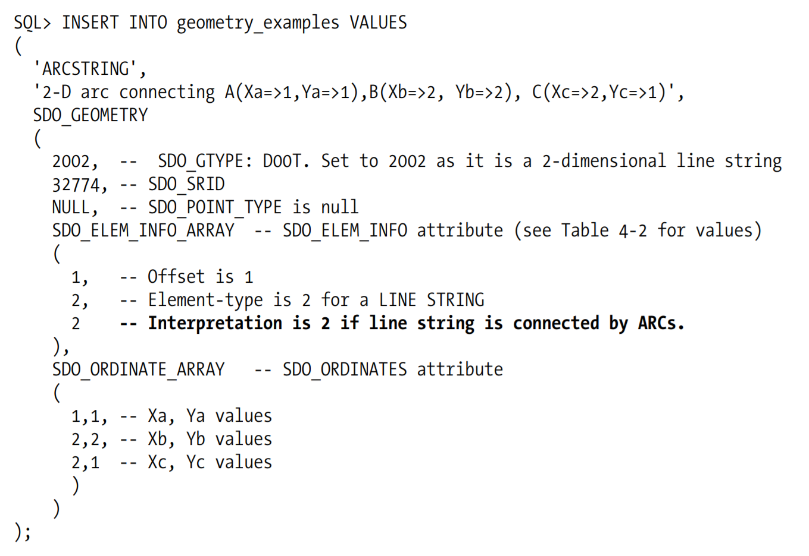
Creating lines (2)
You can create arced lines using Oracle Spatial

Slide 15
Spatial Metadata (1)
Oracle Spatial treats all the objects in a single SDO_GEOMETRY column of a table as a spatial layer.
To perform validation, index creation, and querying with respect to each spatial layer, you need to specify the appropriate metadata for each layer.
The number of dimensions
The bounds for each dimension
The tolerance for each dimension
The coordinate system
This information for each spatial layer is populated in the USER_SDO_GEOM_METADATA dictionary view.
--update metadata view
INSERT INTO user_sdo_geom_metadata
(TABLE_NAME,
COLUMN_NAME,
DIMINFO,
SRID)
VALUES(
'GREGION',
'shape',
SDO_DIM_ARRAY(
SDO_DIM_ELEMENT('X',0,500,0.005),
SDO_DIM_ELEMENT('Y',0,500,0.005)
),
NULL
);
SDO_DIM_ELEMENT described on next slide

Slide 16
Spatial Metadata (2)
SDO_DIM_ELEMENTS consist of:
SDO_DIMNAME the name of dimension, e.g., 'Longitude' or 'Latitude' OR 'X' or 'Y'. Not interpreted by Oracle Spatial.
SDO_LB and SDO_UB define the lower bound and the upper bound limits for the values in a specific dimension.
--update metadata view
INSERT INTO user_sdo_geom_metadata
(TABLE_NAME,
COLUMN_NAME,
DIMINFO,
SRID)
VALUES(
'GREGION',
'shape',
SDO_DIM_ARRAY(
SDO_DIM_ELEMENT('X',0,500,0.005),
SDO_DIM_ELEMENT('Y',0,500,0.005)
),
NULL
);
SDO_TOLERANCE specifies degree of precision for spatial data. It essentially specifies the distance that two values must be apart to be considered different.
For example, if the tolerance is 0.5 and the distance between two points A and B is less than 0.5, then points A and B are considered to be at the same location.
SDO_DIM_ELEMENT

Slide 17
Spatial Indexes
Needed to utilize certain spatial operators
Creating spatial indexes on the SDO_GEOMETRY columns is one of the first steps to undertake when enabling proximity analysis
--create spatial index
CREATE INDEX gregion_spatial_index
ON GREGION(shape)
INDEXTYPE IS MDSYS.SPATIAL_INDEX;

Slide 18
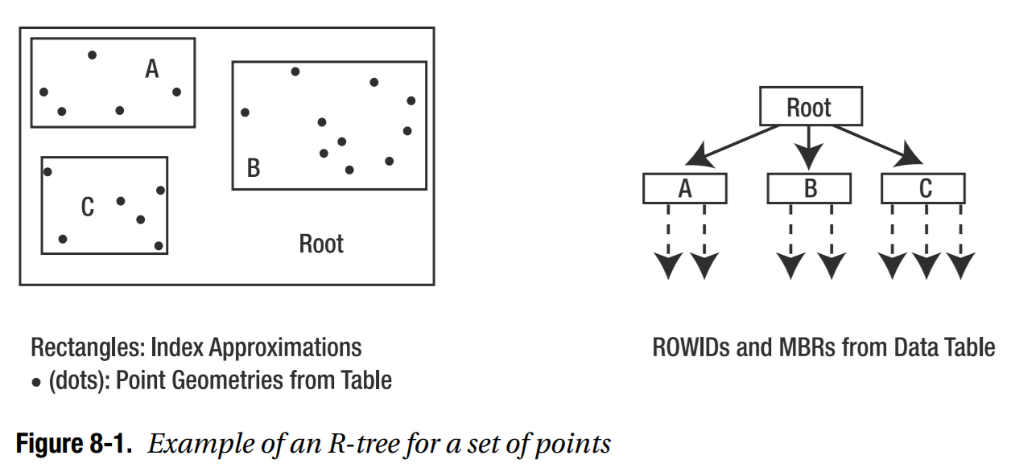
R Tree Indexes
R-trees are tree data structures used for spatial access methods, i.e., for indexing multi- dimensional information such as geographical coordinates, rectangles or polygons.
They group nearby objects and represent them with their minimum bounding rectangle (MBR) in the next higher level of the tree.
The "R" in R-tree is for rectangle. Since all objects lie within this bounding rectangle, a query that does not intersect the bounding rectangle also cannot intersect any of the contained objects.
At the leaf level, each rectangle describes a single object; at higher levels the aggregation of an increasing number of objects.

Slide 19
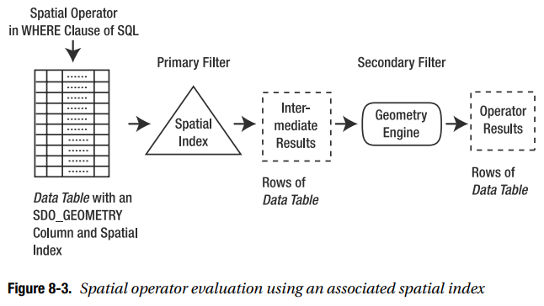
Spatial Query Mechanics
Since spatial operators are tied to the spatial index, they are, in most cases, evaluated in a two-stage filtering mechanism involving the spatial index.
A spatial operator is first evaluated using the spatial index as the primary filter.
Here, approximations in the index (the MBRs stored in the spatial index table) are used to identify a candidate set of rows
The identified rows are then passed through the Geometry Engine -- the secondary filter -- to return the correct set of rows for the specified operator

Slide 20
Spatial Operators (see variants on website)
SDO_WITHIN_DISTANCE
-- Lions within a radius of a certain pond
select l.lion_id
from GLION l, GPOND p
where p.pond_id = 'P1' and
sdo_within_distance(l.location, p.shape, 'distance = 150') = 'TRUE';
SDO_NN (nearest neighbor)
--Nearest ponds to a particular lion -- the 1 in SDO_NN_DISTANCE must match 4th param in SDO_NN
SELECT p.POND_ID, SDO_NN_DISTANCE(1) dist
FROM GLION l, GPOND p
WHERE l.LION_ID = 'L2' AND
SDO_NN(p.shape, l.location, 'SDO_NUM_RES = 3', 1) = 'TRUE';

Slide 21
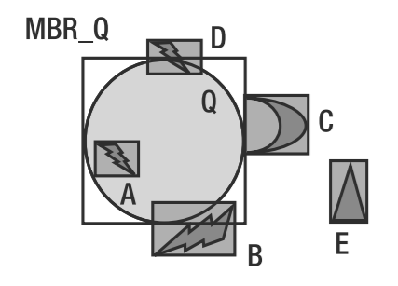
SDO_RELATE and SDO_FILTER
SDO_RELATE: This operator identifies all geometries that interact in a specified manner with a query geometry. The specified type of interaction could involve intersection, touching the boundaries, being completely inside, and so on.
SDO_FILTER: This operator identifies all geometries whose MBRs intersect with the MBR of a query geometry. This operator primarily uses the spatial index without invoking a Geometry Engine function.
MBRs A, B, C & D all are at least partially on or in the circle Q.
Even points in B below the circle will be retrieved!

Slide 22
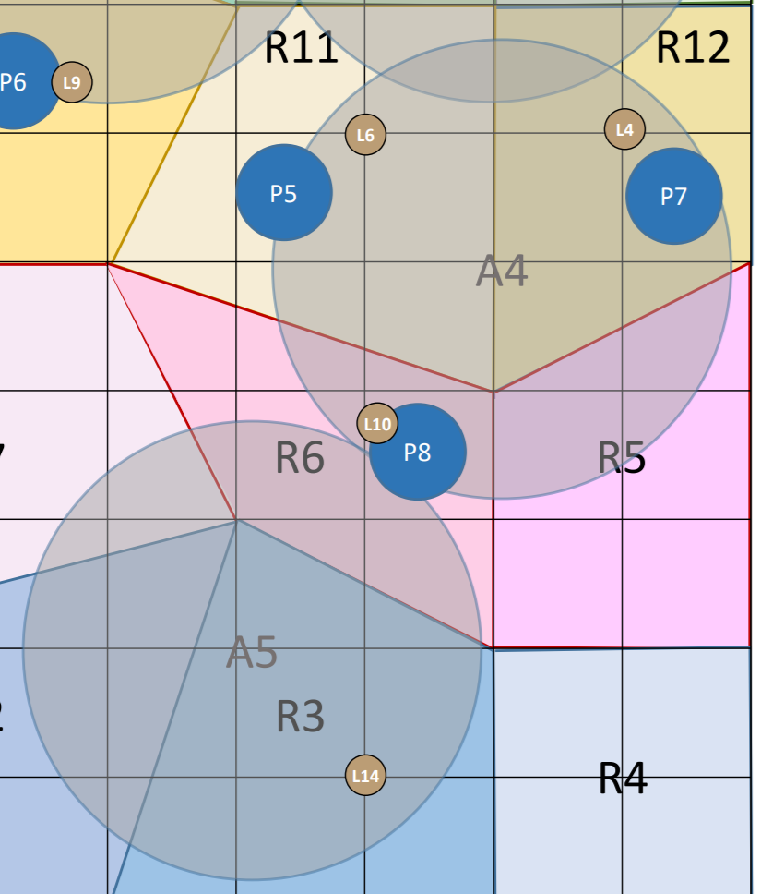
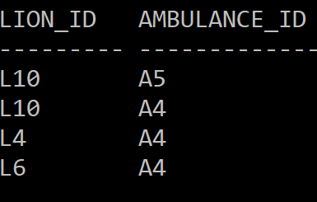
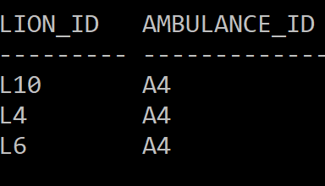
Difference between quick SDO_FILTER and accurate SDO_RELATE
select l.lion_id, a.ambulance_id from glion l, gambulance a, gregion r where SDO_FILTER(l.location, a.shape) = 'TRUE' and SDO_INSIDE(l.location, r.shape) = 'TRUE' and r.region_id in ('R5', 'R6', 'R11', 'R12') order by 1;
select l.lion_id, a.ambulance_id from glion l, gambulance a, gregion r where SDO_RELATE(l.location, a.shape, 'mask = INSIDE') = 'TRUE' and SDO_INSIDE(l.location, r.shape) = 'TRUE' and r.region_id in ('R5', 'R6', 'R11', 'R12') order by 1;
Lion L10

Slide 23
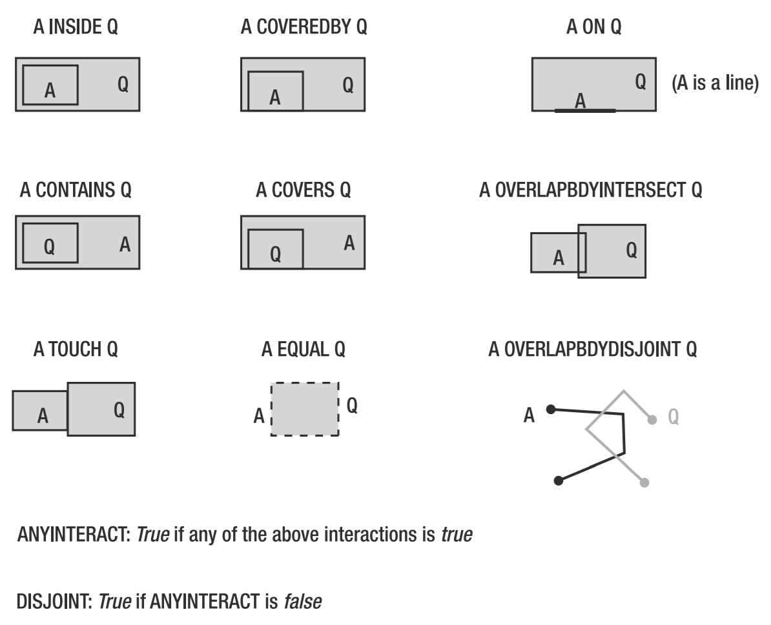
Masks and Simplified Operators
Mask | Inverse Mask
INSIDE | CONTAINS
COVEREDBY | COVERS
ON
TOUCH
OVERLAPBDYINTERSECT
OVERLAPBDYDISJOINT
EQUAL
ANYINTERACT
DISJOINT
select l.lion_id, a.ambulance_id from glion l, gambulance a, gregion r where SDO_RELATE(l.location, a.shape, 'mask = INSIDE') = 'TRUE' and SDO_INSIDE(l.location, r.shape) = 'TRUE' and r.region_id in ('R5', 'R6', 'R11', 'R12') order by 1;
To make a Mask an Operator, just prefix with SDO_

Slide 24
More sample queries available
-- inside the pond
SELECT l.LION_ID, p.POND_ID FROM GLION l, GPOND p WHERE SDO_RELATE(l.location, p.shape, 'mask = INSIDE') = 'TRUE'
-- inside or on the boundary of the pond SELECT l.LION_ID, p.POND_ID FROM GLION l, GPOND p WHERE SDO_RELATE(l.location, p.shape, 'mask = INSIDE+COVEREDBY') = 'TRUE';
Also see: http://jackmyers.info/db/files/spatial/spatial_lion_queries.txt

